Slide 1
Formation of the Extratropical Cyclone (Cyclogenesis)
geog-www.sbs.ohio-state.edu/courses/G620/.../ASP620Lecture10.ppt

Slide 2
Cyclogenesis
Extratropical cyclones often form when an upper level trough (e.g. a shortwave) approaches a front that is stationary or moving relatively slowly.
In order for a low pressure system to form at the surface, there must be net divergence in the column of air and the air must start to rotate counterclockwise.

Slide 3
Cyclogenesis (Cont.)
During the development of the extratropical cyclone the system typically tilts to the west with height.
This means that the upper level trough is usually found to the west of the surface trough or low.

Slide 4
Cyclogenesis (Cont.)
N
E
Upper Level Shortwave
at 500 mb
Upper Level
Divergence
Positive
Vorticity

Slide 5
Cyclogenesis (Cont.)
Colder air mass
N
H
E
Upper Level
Shortwave
at 500 mb
H
Warmer air mass

Slide 6
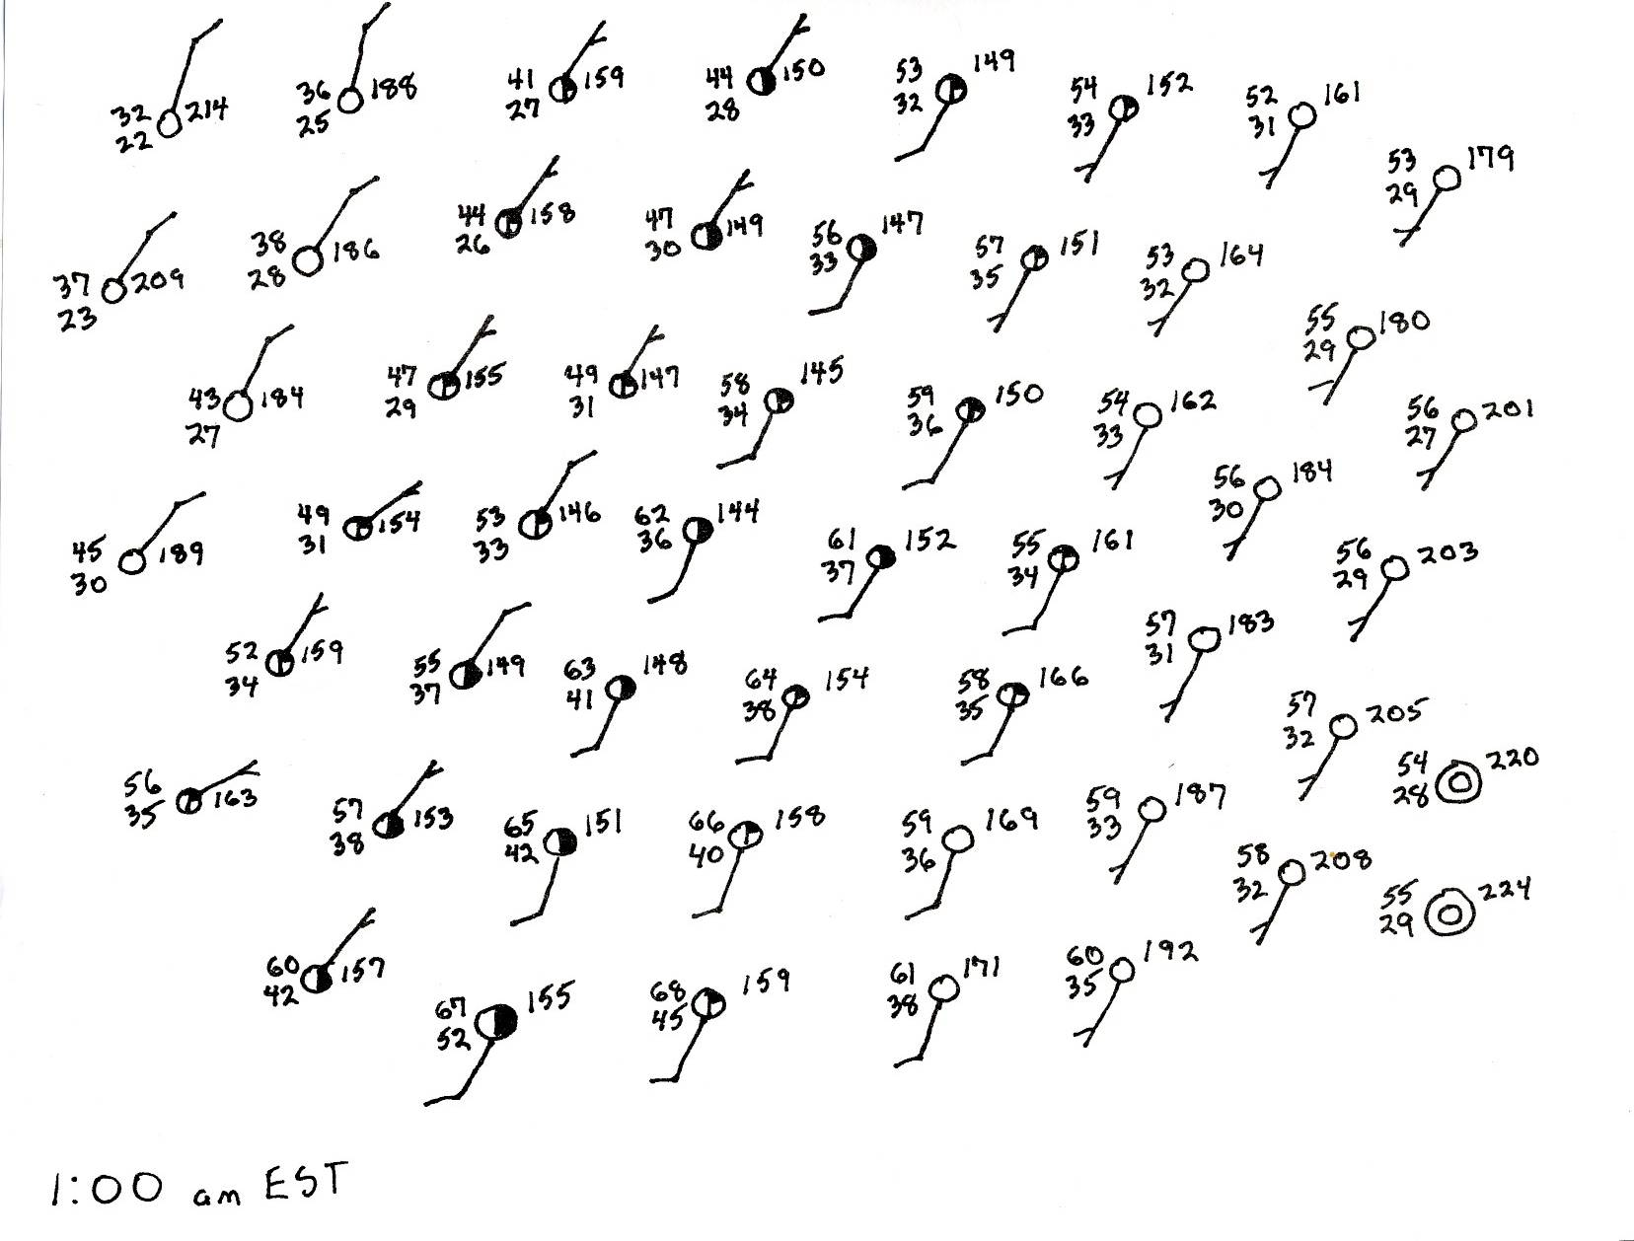

Slide 7
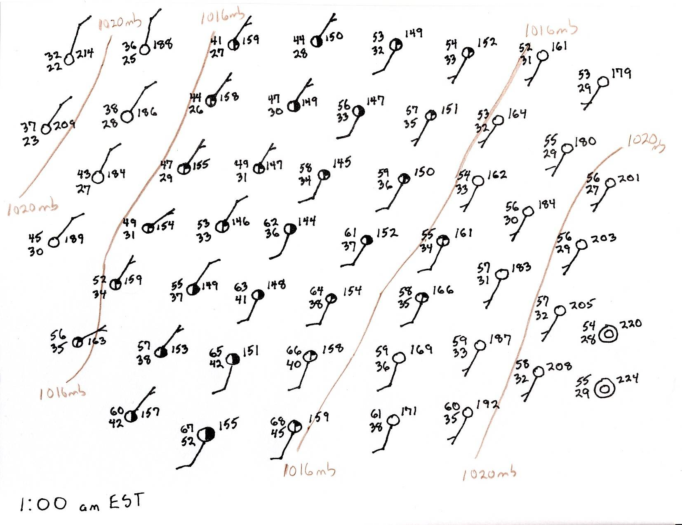

Slide 8
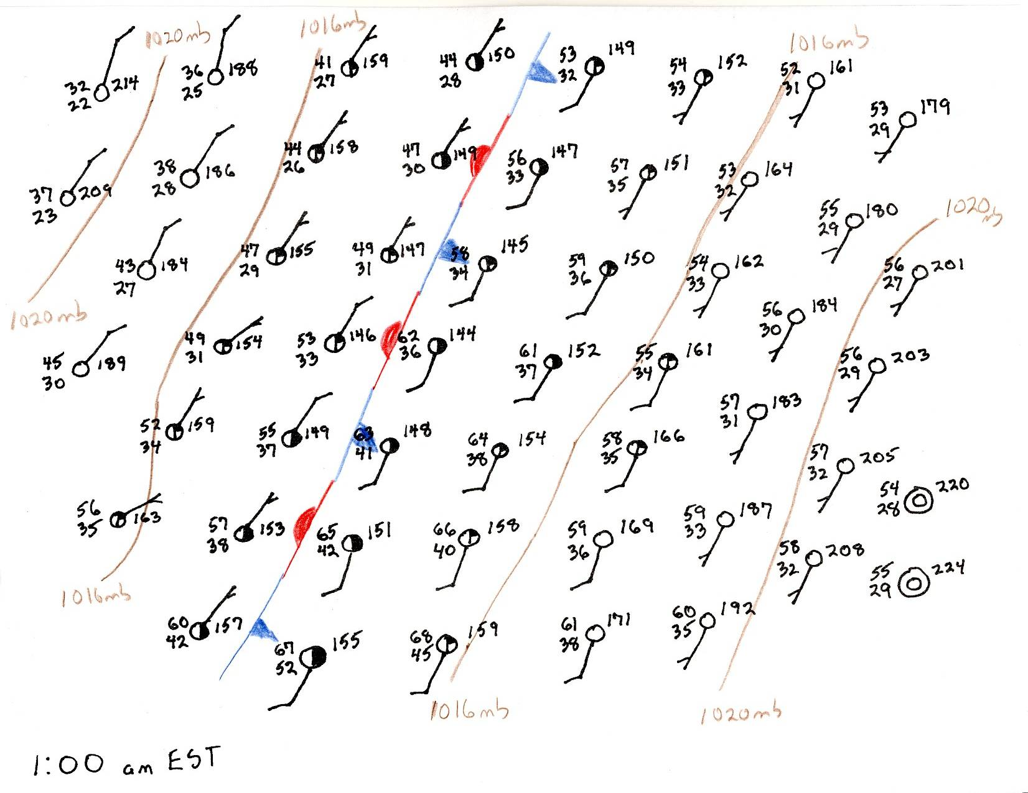

Slide 9
Cyclogenesis (Cont.)
Once the stationary front begins to rotate cyclonically the eastern section becomes a warm front as warmer air begins to move north and to push out colder air.
The western section of the front begins to move south and becomes a cold front as the colder air begins to push out warmer air.

Slide 10
Cyclogenesis (Cont.)
Colder air is denser than warmer air and the colder air is more affected by the gravitational force.
The colder air tends to stay near the surface, while the warmer air tends to rise over denser colder air.

Slide 11
Cyclogenesis (Cont.)
The different densities mean that the warmer air often has a hard time pushing out the denser colder air.
By contrast the denser colder air has much less trouble pushing out the less dense warmer air.

Slide 12
Cyclogenesis (Cont.)
The net result is that cold front moves faster than the warm front and a bend or kink develops along the front.
The bend in the front is called a wave on the front (or frontal wave).

Slide 13
Wave on the Front
Retreating
cold air mass
H
N
E
500 mb flow
H
Warm air mass
H
Developing new cold air mass

Slide 14
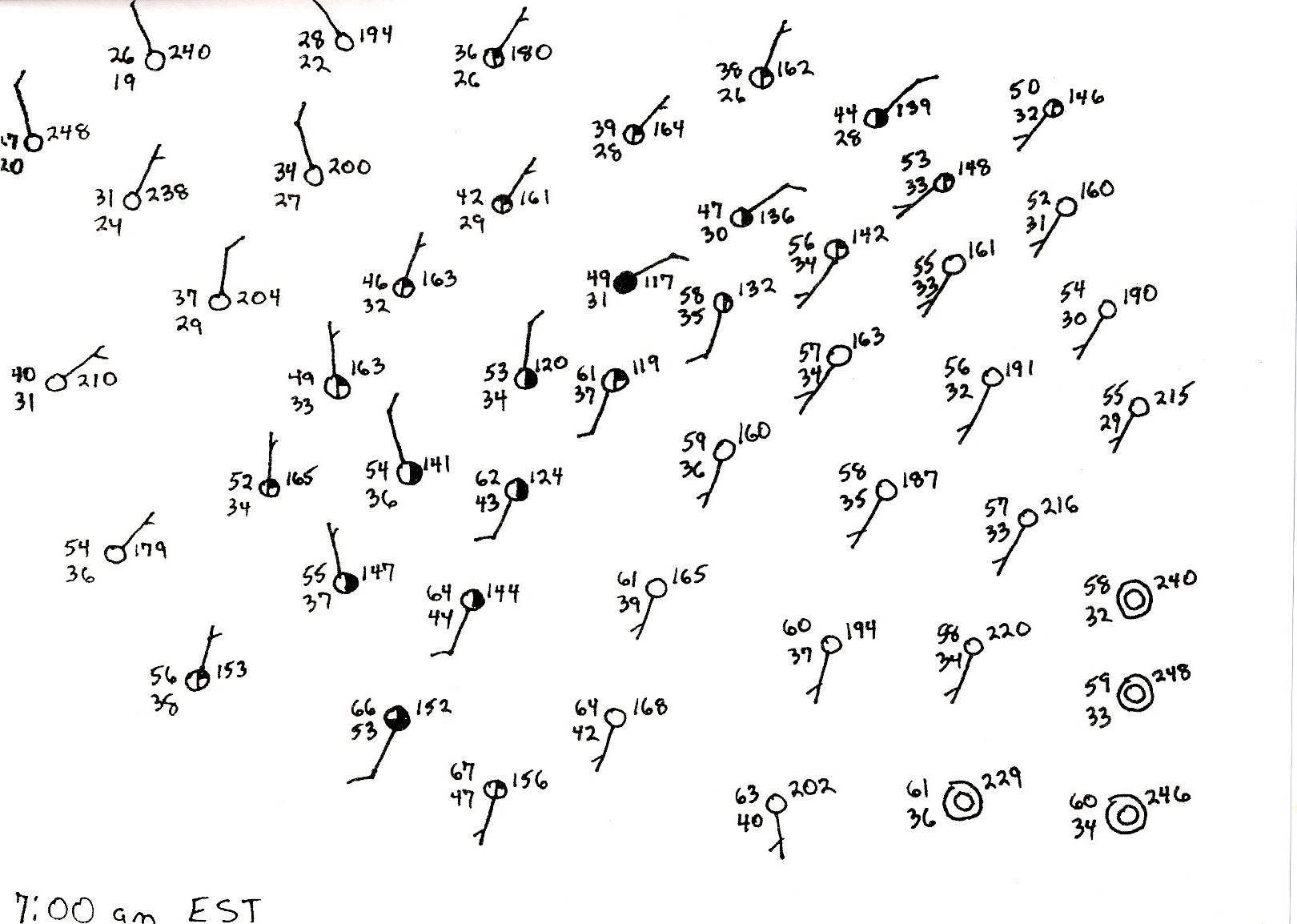

Slide 15
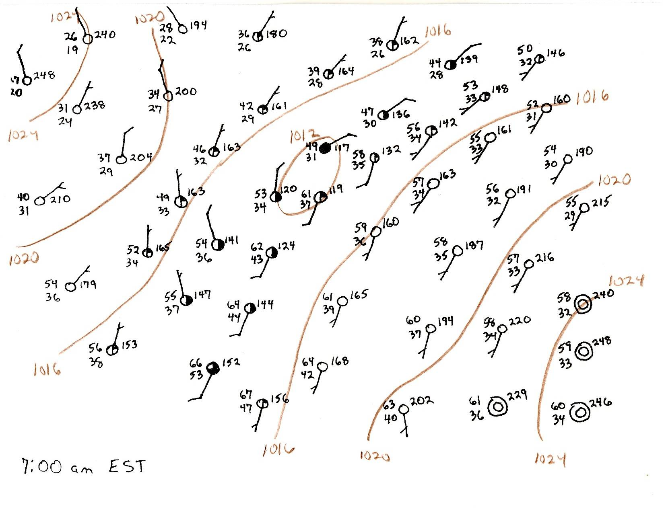

Slide 16
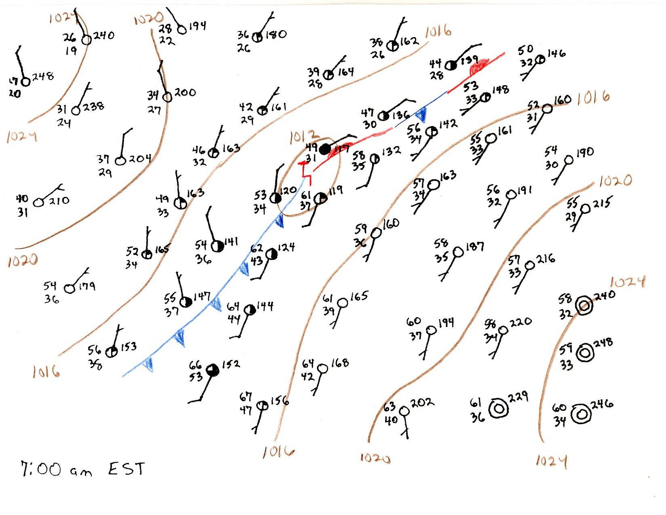

Slide 17
Extratropical Cyclone
N
H
E
H
L
H

Slide 18
Changes at 500 mb
As the colder air moves southward behind the cold front, it causes the 500 mb heights to decrease
As the warmer air moves northward with the warm front, it causes the 500 mb heights to increase ahead of the developing surface low.

Slide 19
Changes at 500 mb (Cont.)
The effects of the advection of the warmer air is to build the downstream ridge.
The effects of the advection of the colder air is to deepen the trough.
Thus, the thermal advection increases the amplitude of the shortwave.

Slide 20
Changes at 500 mb (Cont.)
N
H
500 mb flow
E
H
Warm air advection builds the downstream ridge.
L
Cold air advection deepens the trough at 500 mb.
H

Slide 21
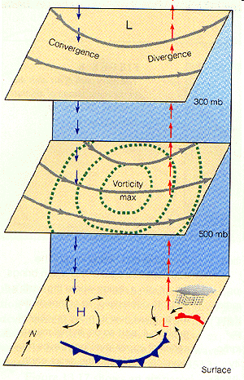
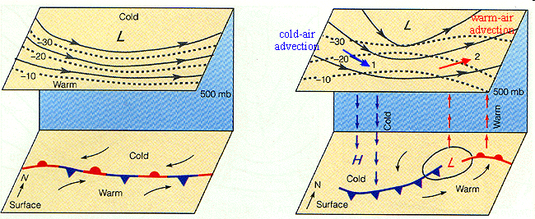
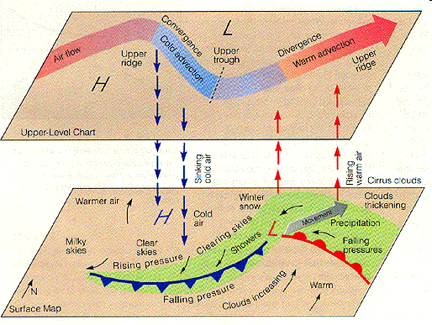
http://www.aos.wisc.edu/~aalopez/aos101/wk14.html

