Slide 1
Escalas dos fenômenos atmosféricos

Slide 2
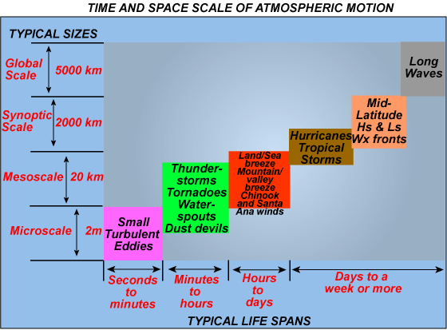
http://apollo.lsc.vsc.edu/classes/met130/notes/chapter9/scales.html

