Slide 1
Evaluation of trends in intensity and speed of extratropical cyclones associated to extreme wave events in the Atlantic Ocean
Ricardo de Camargo & Carolina B. Gramcianinov
IWMO2022 - June 28 to July 01 - Ann Arbor

Slide 2
CONTEXTUALIZATION: Project EXWAVE
EXWAVE: “Extreme wind and wave modeling and statistics in the Atlantic Ocean”
Joint call FCT (Portugal) / FAPESP (Brasil) [2017]:
Centre for Marine Technology and Ocean Engineering, Instituto Superior Técnico, Universidade de Lisboa (CENTEC/IST/UL) – Nov/2018 – 3 years
Dr. Carlos Guedes Soares and Dr. Ricardo M. Campos
Institute for Astronomy, Geophysics and Atmospheric Sciences, Universidade de São Paulo (IAG/USP) – Mar/2019 – 3 years
Dr. Pedro L. da Silva Dias and Dr. Ricardo de Camargo
Camargo and Gramcianinov IWMO2022 - Ann Arbor

Slide 3
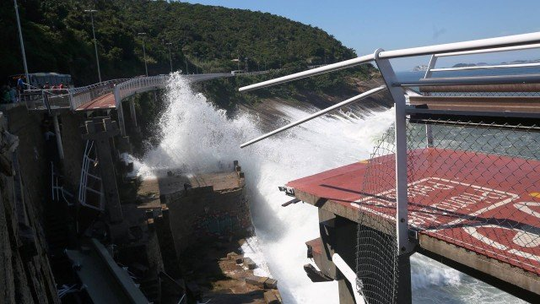
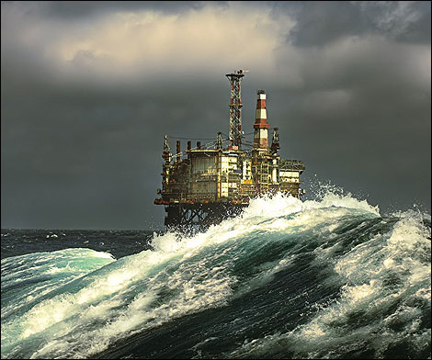
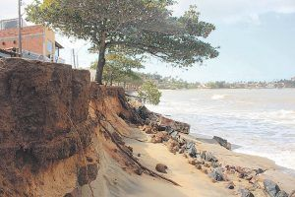
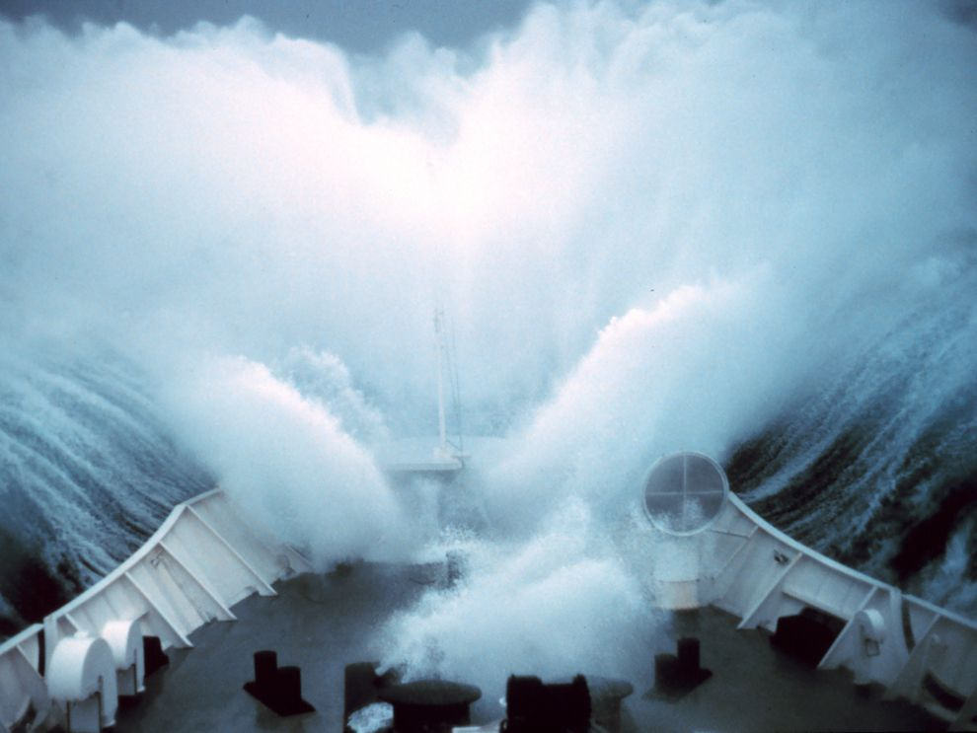
CONTEXTUALIZATION: Motivation
Extreme wave events: big impacts in various aspects
Destruction of coastal and offshore structures;
Risk in naval operations (oil exploration, maintenance/constructions, cargo transport/ship routes)
Port activities;
Coastal erosion.
Saltcoats, Scotland
Gramcianinov et al. - Climatologia e tendência dos extremos de onda gerados por ciclones extratropicais… XIV OMARSAT 12/2021
Camargo and Gramcianinov IWMO2022 - Ann Arbor

Slide 4
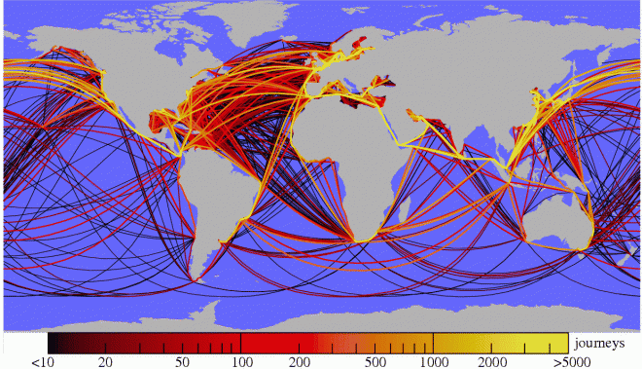
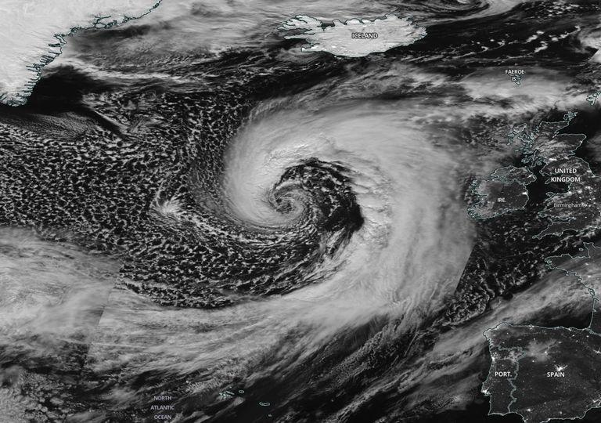
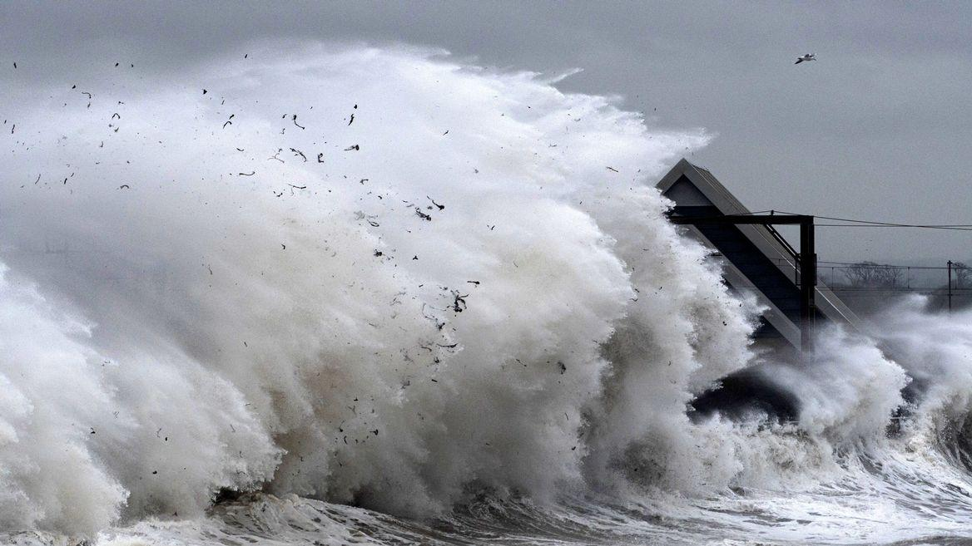
CONTEXTUALIZATION: Motivation
Extratropical Cyclones:
scale and structure allow the development of extreme waves (e.g., da Rocha et al, 2004; Campos et al, 2018).
large role in the weather and climate of mid and high latitudes
impact on ship routes
populous and economically active coasts
Saltcoats, Scotland
Storm Brendan – 13/Jan/2020
Saltcoats, Scotland
Kaluza et al. (2010) - https://doi.org/10.1098/rsif.2009.0495
Gramcianinov et al. - Climatologia e tendência dos extremos de onda gerados por ciclones extratropicais… XIV OMARSAT 12/2021
Camargo and Gramcianinov IWMO2022 - Ann Arbor

Slide 5
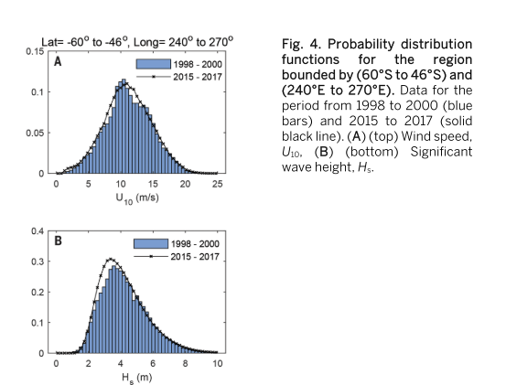
CONTEXTUALIZATION: Introduction
Climatologies and wave and cyclone trends/changes are usually done separately;
challenge in understanding what forces observed waves to change
the change in the distribution (pdf) of waves does not correspond to that of winds (Young & Ribal., 2019)
Complex relationship:
wave field has local and remote signal overlap (swell)
Gramcianinov et al. - Climatologia e tendência dos extremos de onda gerados por ciclones extratropicais… XIV OMARSAT 12/2021
Camargo and Gramcianinov IWMO2022 - Ann Arbor

Slide 6
CONTEXTUALIZAÇÃO: Introdução
CONTEXTUALIZATION: Introduction
More cyclones don't mean necessarily more extreme wave events:
not every cyclone generates extreme waves
asymmetrical and variable structure throughout the life cycle
other parameters act in the generation of waves: speed and trajectory of the cyclones
Gramcianinov et al. (2020a)
Gramcianinov et al. - Climatologia e tendência dos extremos de onda gerados por ciclones extratropicais… XIV OMARSAT 12/2021
Camargo and Gramcianinov IWMO2022 - Ann Arbor

Slide 7
AIM AND SCIENTIFIC QUESTIONS
The aim is to investigate the role of cyclones in extreme wave weather trends in 42 years of reanalysis, having the following guiding questions:
What is the distribution of extratropical cyclones that generate extreme waves in the Atlantic Ocean?
What are the average characteristics of cyclone cases and associated waves?
Is there any significant trend in these cases in recent decades?
?
Gramcianinov et al. - Climatologia e tendência dos extremos de onda gerados por ciclones extratropicais… XIV OMARSAT 12/2021
Camargo and Gramcianinov IWMO2022 - Ann Arbor

Slide 8
DATA
Dataset and analysis details:
ERA5, hourly data (C3S, 2017; Hersbach et al., 2020)
Climatology covers the period from 1979 to 2020
Trends are calculated by the difference between 2000-2020 and 1979-1999
Focus on the summer and winter of each hemisphere: DJF and JJA
Significance test:
Monte Carlo for the genesis and trajectories of cyclones (Hodges, 2008);
t test for the parameters associated with the cases.
Gramcianinov et al. - Climatologia e tendência dos extremos de onda gerados por ciclones extratropicais… XIV OMARSAT 12/2021
Camargo and Gramcianinov IWMO2022 - Ann Arbor

Slide 9
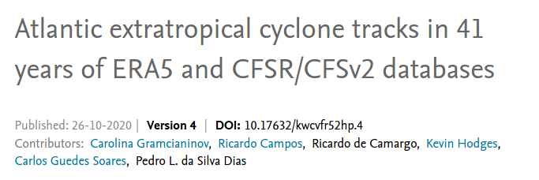
DATA
Cyclone Base:
“Atlantic extratropical cyclone tracks database''
(AETC, Gramcianinov et al., 2020c)
Product of Projeto EXWAV, evaluated in
Gramcianinov et al. (2020b)
Method::
TRACK (Hodges 1994, 1995, 1999)
Relative vorticity in 850 hPa
Duration > 24 h and displacement > 1000 km
Gramcianinov et al. - Climatologia e tendência dos extremos de onda gerados por ciclones extratropicais… XIV OMARSAT 12/2021
Camargo and Gramcianinov IWMO2022 - Ann Arbor

Slide 10
METHODS
Extreme event: percentiles (75th, 90th, 95th, 99th) in each grid point;
percentiles calculated for independent events (window = 96h) and for each season (important for summer)
grouping points above percentile in “extreme regions” to association with the cyclones
only points with shww > 50% of the swh (to exclude swell)
Gramcianinov et al. 2020a
Gramcianinov et al. - Climatologia e tendência dos extremos de onda gerados por ciclones extratropicais… XIV OMARSAT 12/2021
Camargo and Gramcianinov IWMO2022 - Ann Arbor

Slide 11
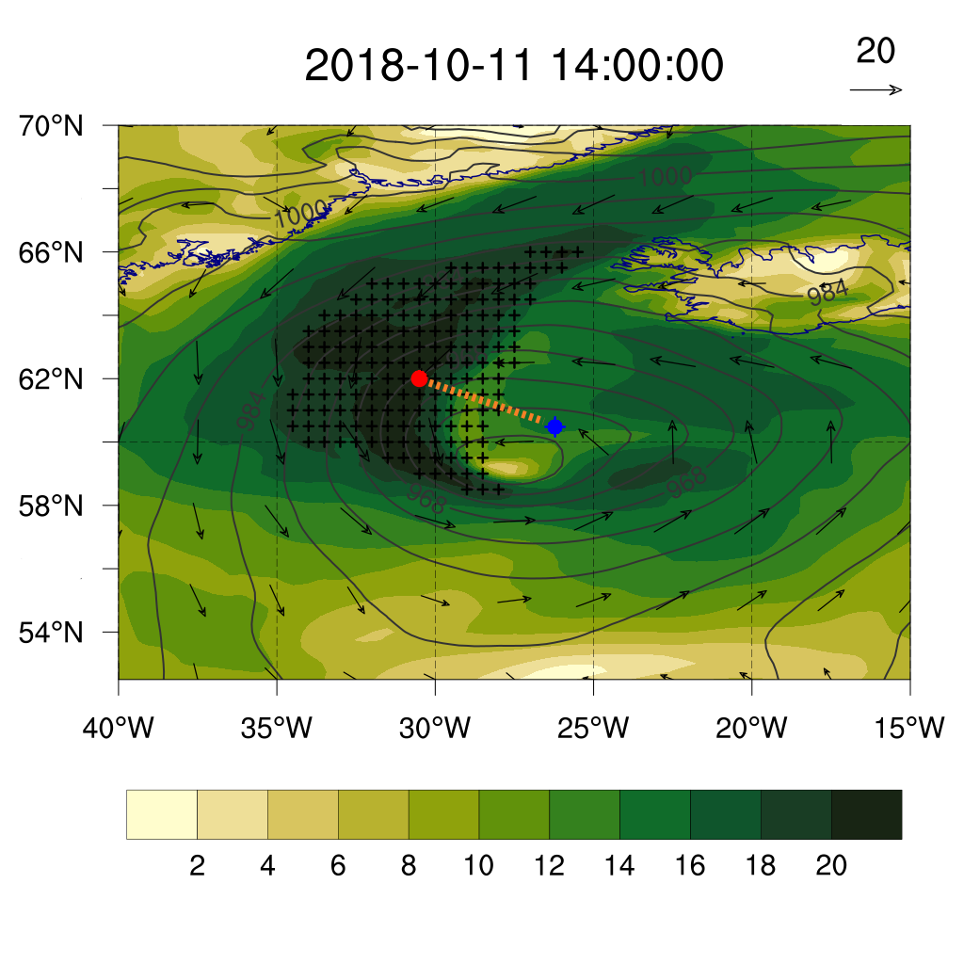
METHODS
(I) grid points above percentile
(II) grouping in “extreme regions”
Gramcianinov et al. (2021b)
(III) association to the cyclones
baroclinic disturbances (2000 - 3000 km)
time for developing most energetic waves (Hasselmann et al, 1973; Ardhuin and Orfila, 2018)
if:
dist <= 1500 km AND cyclone exists 24h before
extreme region and cyclone are associated
Gramcianinov et al. - Climatologia e tendência dos extremos de onda gerados por ciclones extratropicais… XIV OMARSAT 12/2021
Camargo and Gramcianinov IWMO2022 - Ann Arbor

Slide 12
METHODS
Additional parameters to the events
Hs mean and max;
mean wave period
mean wind direction.
cyclone sector where the extremes occurs
intensity (vorticity, 10m wind speed);
speed of cyclone propagation;
Gramcianinov et al. - Climatologia e tendência dos extremos de onda gerados por ciclones extratropicais… XIV OMARSAT 12/2021
Camargo and Gramcianinov IWMO2022 - Ann Arbor

Slide 13
Results and Discussion

Slide 14
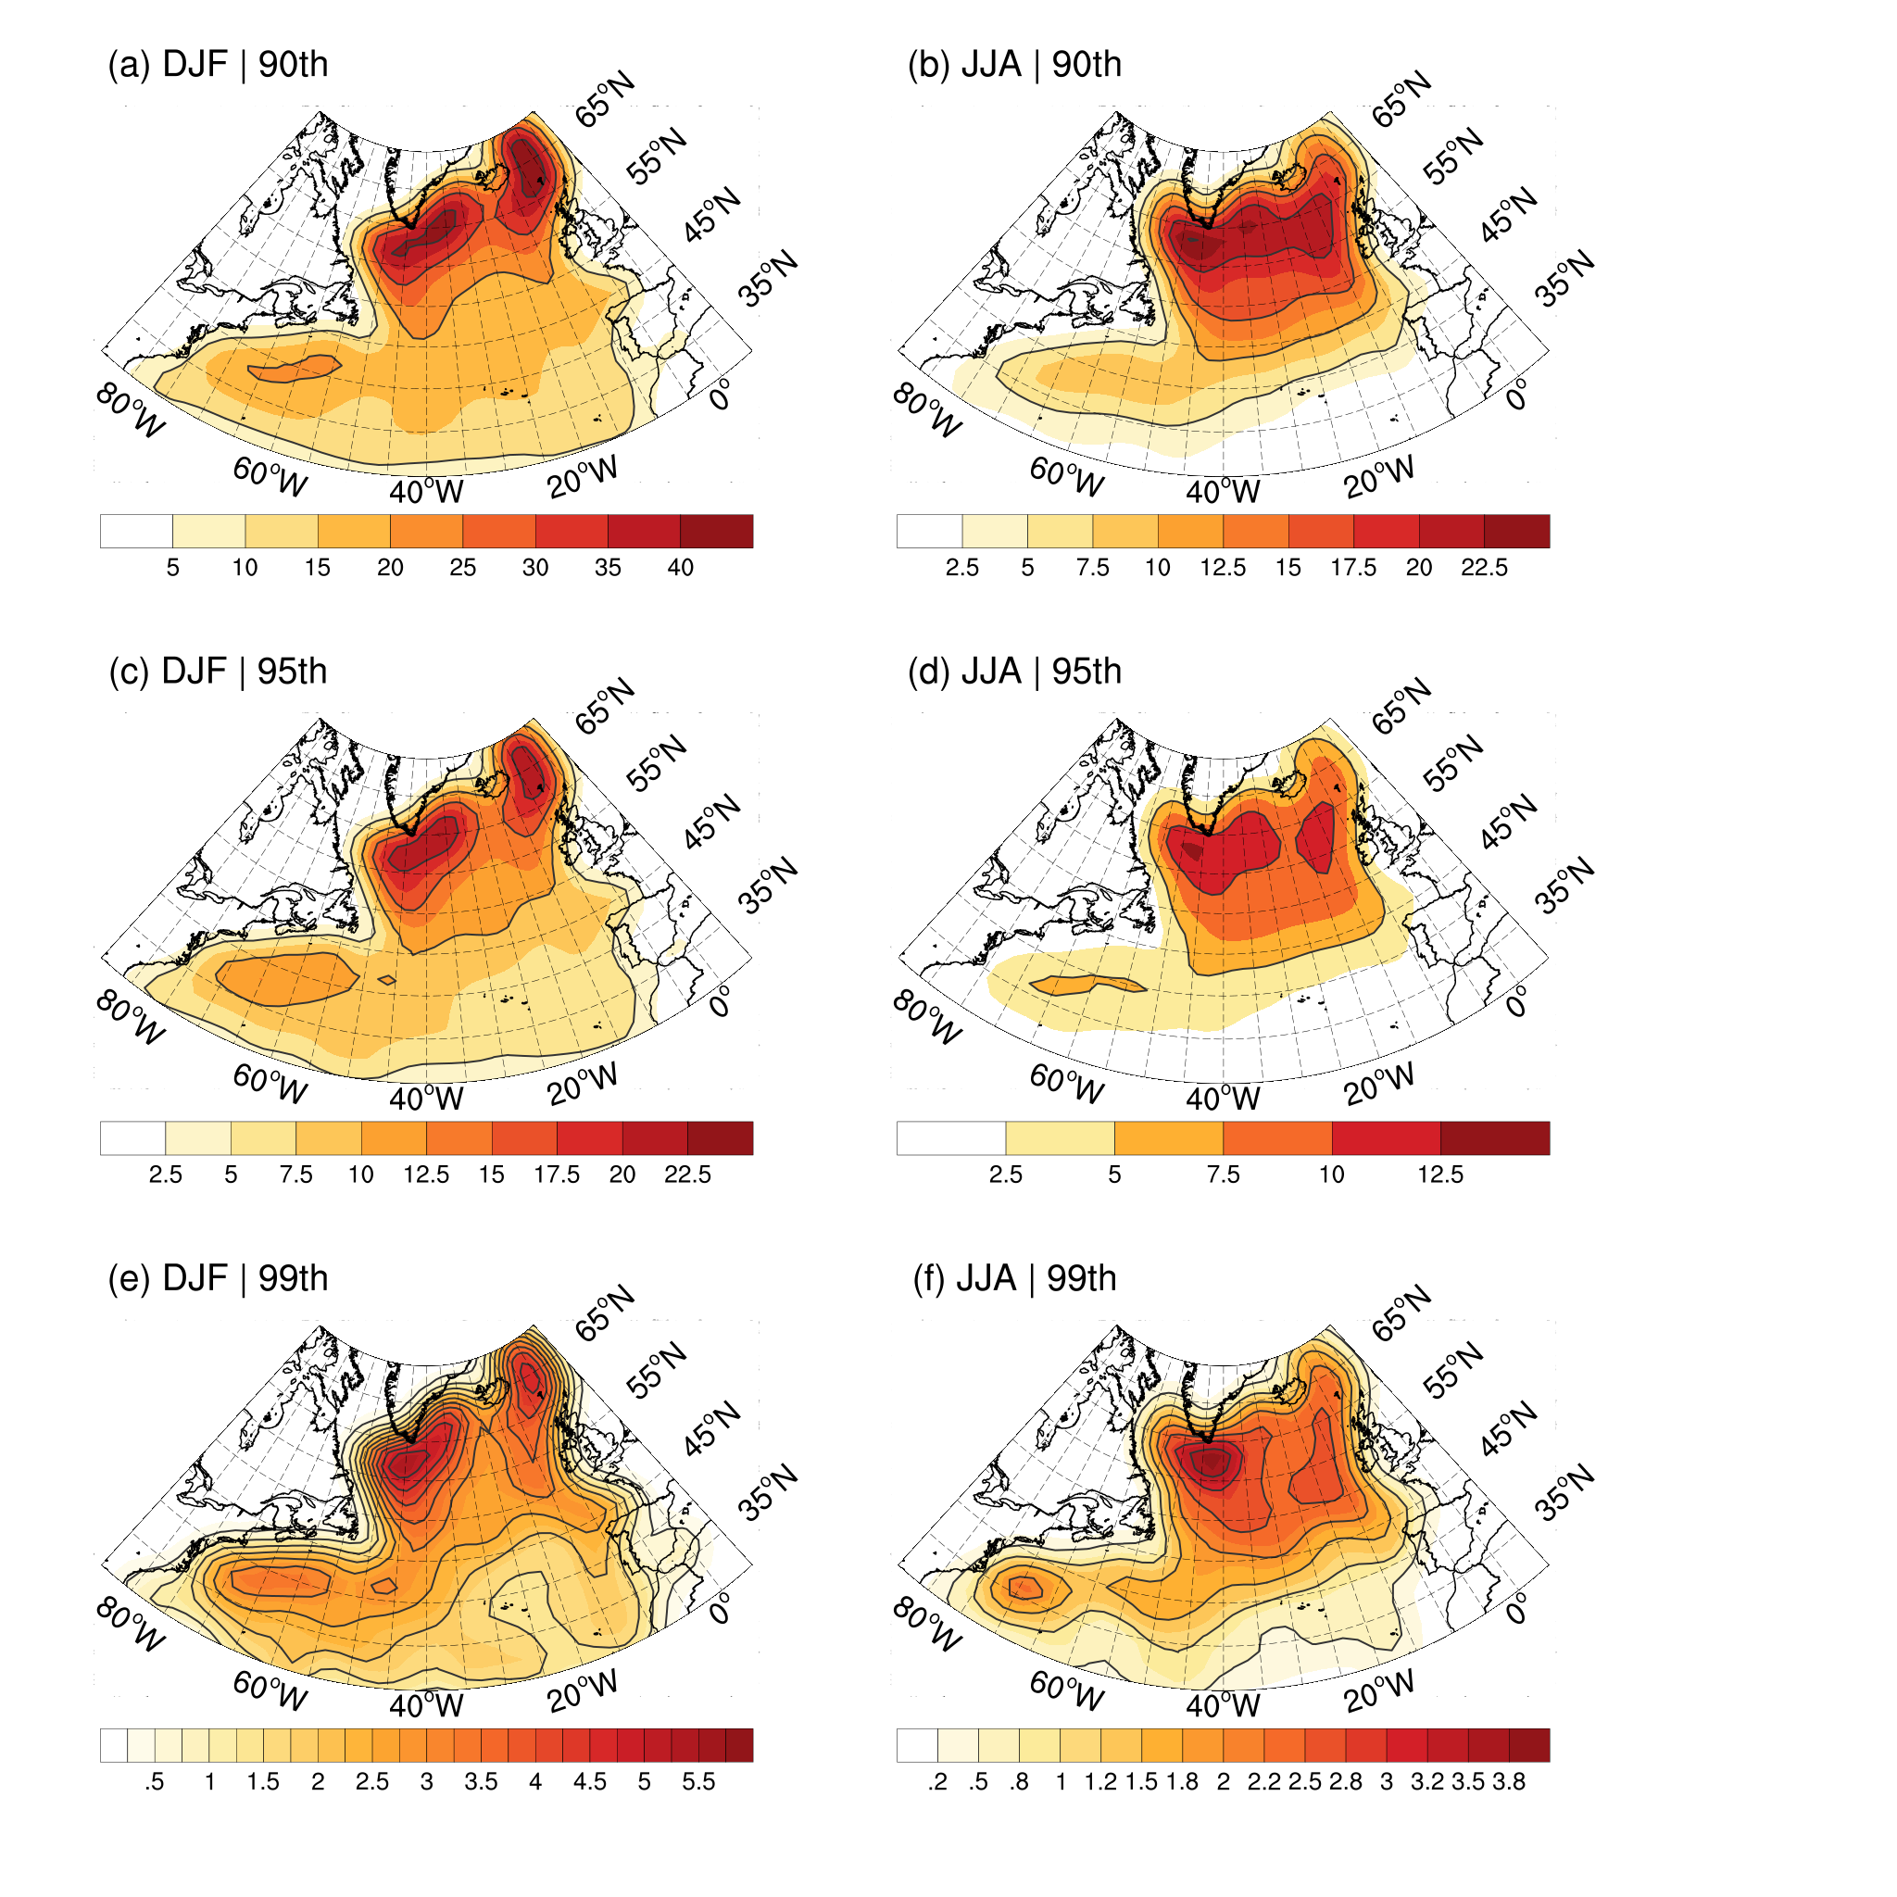
RESULTS AND DISCUSSION
Map of the occurrence of wave extremes:
center of mass of the extreme region
considers all time steps: there is no temporal relationship
high densities indicate high density of events or longer events
Gramcianinov et al. - Climatologia e tendência dos extremos de onda gerados por ciclones extratropicais… XIV OMARSAT 12/2021
Camargo and Gramcianinov IWMO2022 - Ann Arbor

Slide 15
RESULTADOS & DISCUSSÃO
RESULTS & DISCUSSION
RESULTS AND DISCUSSION
→ high densities indicate high density of events or longer events
3 important regions that stand out more or less depending on season and percentile
east coast of the USA
Greenland
Northern British Isles
Reproduction of the pattern of more cases at high latitudes as reported in the literature
A lot of difference in the occurrence of cases between summer (JJA) and winter (DJF)
Gramcianinov et al. - Climatologia e tendência dos extremos de onda gerados por ciclones extratropicais… XIV OMARSAT 12/2021
Camargo and Gramcianinov IWMO2022 - Ann Arbor

Slide 16
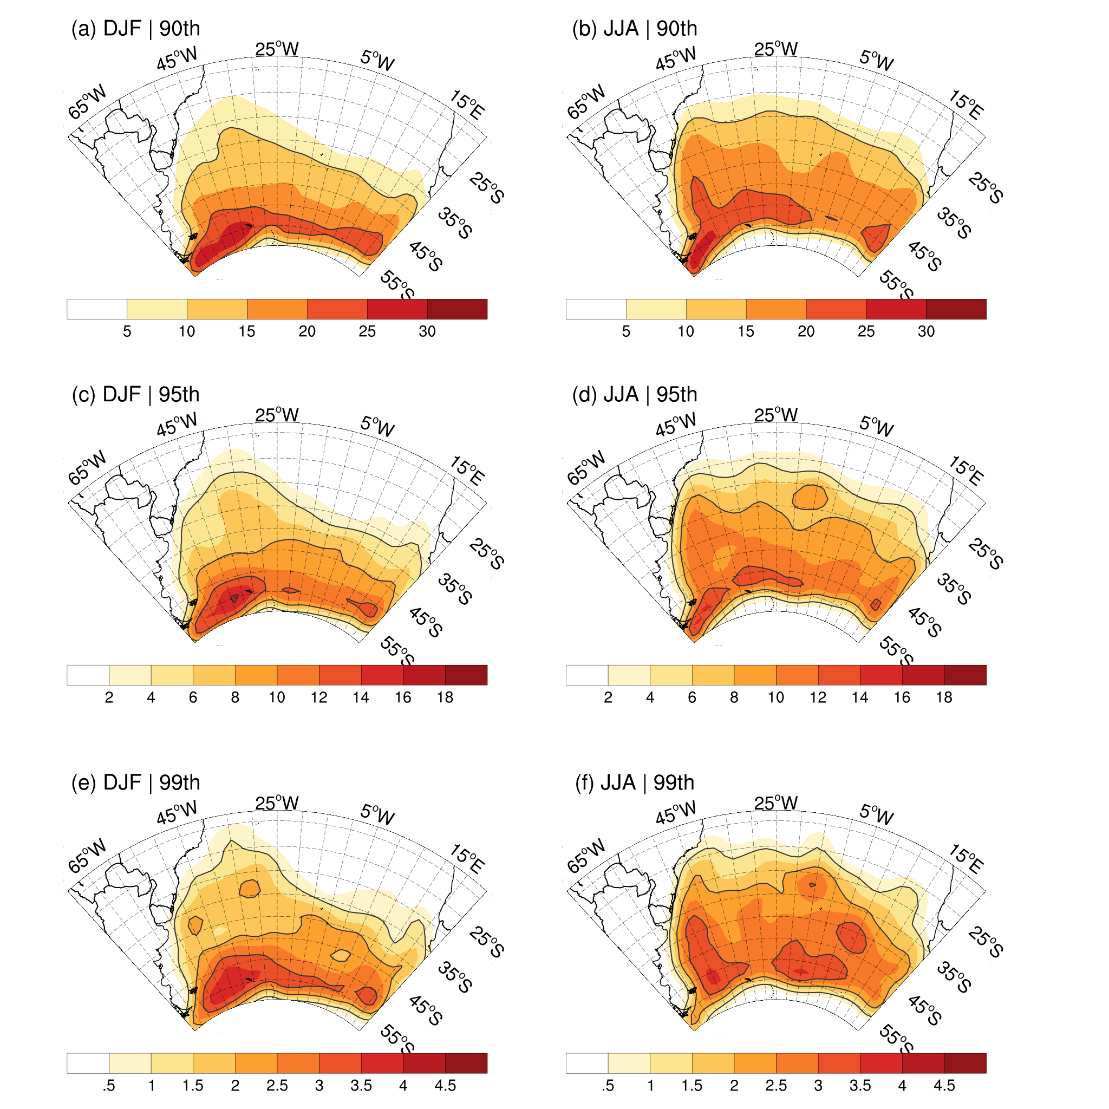
RESULTADOS & DISCUSSÃO
RESULTS & DISCUSSION
RESULTS AND DISCUSSION
→ high densities indicate high density of events or longer events
3 important regions that stand out more or less depending on season and percentile
east of Drake Passage
Along the coast of South America (45ºS-25ºS)
Central-East range between 55ºS and 40ºS.
Reproduction of the pattern of more cases at high latitudes as reported in the literature (55ºS and 45ºS range)
highlight to the coast of South America
Little difference between summer and winter
Gramcianinov et al. - Climatologia e tendência dos extremos de onda gerados por ciclones extratropicais… XIV OMARSAT 12/2021
Camargo and Gramcianinov IWMO2022 - Ann Arbor

Slide 17
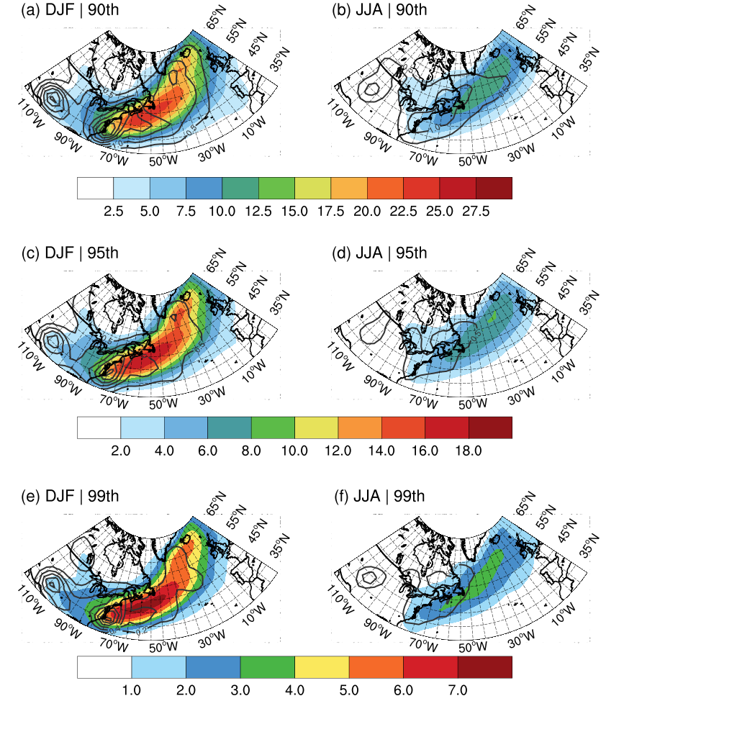
RESULTADOS & DISCUSSÃO
RESULTS & DISCUSSION
RESULTS AND DISCUSSION
Density of genesis (contour) and cyclone trajectories associated with wave extremes.
The preferred range of trajectories follows a similar pattern to the climatological one (e.g. Hoskins & Hodges 2002):
northeast orientation crossing the basin
two branches appear: the main one, which leaves the US coast, and a secondary one in the North North Atlantic (NNA) region.
The secondary branch loses importance in the higher percentiles → most of the cyclones associated with wave extremes in the domain are generated at the western edge.
Gramcianinov et al. - Climatologia e tendência dos extremos de onda gerados por ciclones extratropicais… XIV OMARSAT 12/2021
Camargo and Gramcianinov IWMO2022 - Ann Arbor

Slide 18
RESULTADOS & DISCUSSÃO
RESULTS & DISCUSSION
RESULTS AND DISCUSSION
Extreme events in the NNA are not just swell (e.g., Young et al. 1999) but are heavily influenced by local systems:
cyclones generated at the western edge, probably intensified by flows from the warm waters of the Gulf Stream (e.g., Grise et al. 2013).
This region of generation and intensification of cyclones is also important in the local wave extreme, affecting the entire east coast;
however, developing cyclones are weaker and smaller compared to mature cyclones arriving in the NNA;
do not yet have a long runway and directional persistence of winds to generate very energetic waves
Gramcianinov et al. - Climatologia e tendência dos extremos de onda gerados por ciclones extratropicais… XIV OMARSAT 12/2021
Camargo and Gramcianinov IWMO2022 - Ann Arbor

Slide 19
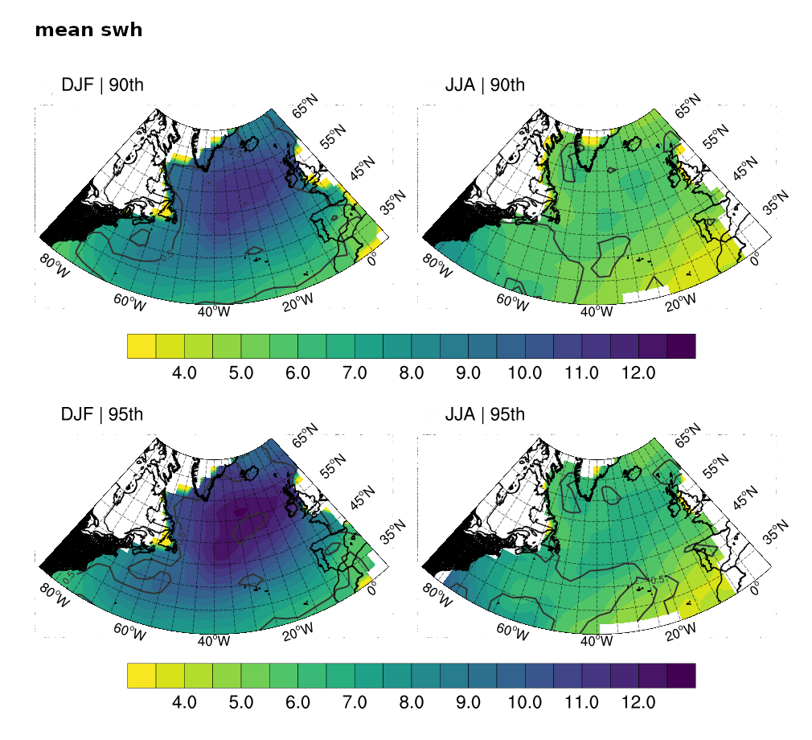
RESULTADOS & DISCUSSÃO
RESULTS & DISCUSSION
RESULTS AND DISCUSSION
Extreme events in the NNA are not just swell (e.g., Young et al. 1999) but are heavily influenced by local systems:
cyclones generated at the western edge, probably intensified by flows from the warm waters of the Gulf Stream (e.g., Grise et al. 2013).
This region of generation and intensification of cyclones is also important in the local wave extreme, affecting the entire east coast;
however, developing cyclones are weaker and smaller compared to mature cyclones arriving in the NNA;
do not yet have a long runway and directional persistence of winds to generate very energetic waves
direct impact on the mean Hs of the cases
Gramcianinov et al. - Climatologia e tendência dos extremos de onda gerados por ciclones extratropicais… XIV OMARSAT 12/2021
Camargo and Gramcianinov IWMO2022 - Ann Arbor

Slide 20
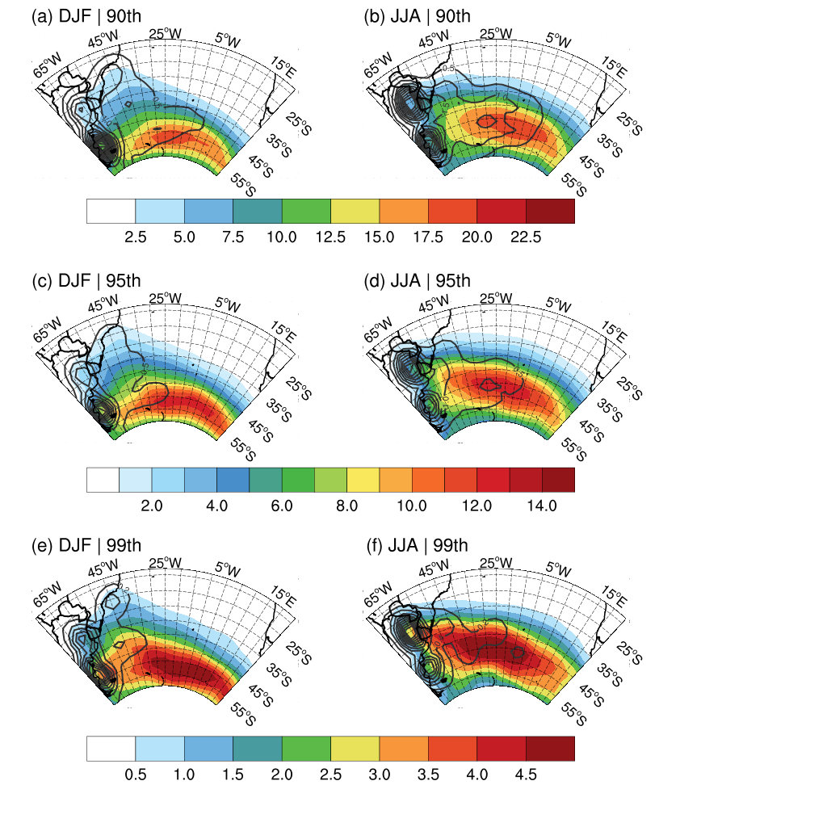
RESULTADOS & DISCUSSÃO
RESULTS & DISCUSSION
RESULTS AND DISCUSSION
Density of genesis (contour) and cyclone trajectories associated with wave extremes.
The preferential range of trajectories follows a pattern similar to the climatological one (e.g. Hoskins & Hodges 2005), with a more curved orientation towards the south in winter.
Cyclogenetic regions:
La Plata (LPB) important in both seasons, but predominant in winter (Gramcianinov et al., 2020a, 2021)
Southeast Brasil (SBR) relevant in summer, especially in the highest percentile (99th)
Subtropical cyclones (e.g., Gozzo et al., 2014; da Rocha et al., 2019)
The east-central genesis regions of NA (Dacre & Gray, 2009) and SA (Gramcianinov et al., 2019) are not relevant to the wave extremes in the domains.
Gramcianinov et al. - Climatologia e tendência dos extremos de onda gerados por ciclones extratropicais… XIV OMARSAT 12/2021
Camargo and Gramcianinov IWMO2022 - Ann Arbor

Slide 21
RESULTADOS & DISCUSSÃO
RESULTS & DISCUSSION
RESULTS AND DISCUSSION
As in the NA, the highest average Hs in the cases occur in the east-pole portion, at the exit of the maximum trajectories zone (storm track):
mature cyclones, more intense and with a longer and more persistent track.
Spatial distribution of the mean Hs of the cases in the extreme percentiles
Gramcianinov et al. - Climatologia e tendência dos extremos de onda gerados por ciclones extratropicais… XIV OMARSAT 12/2021
Camargo and Gramcianinov IWMO2022 - Ann Arbor

Slide 22
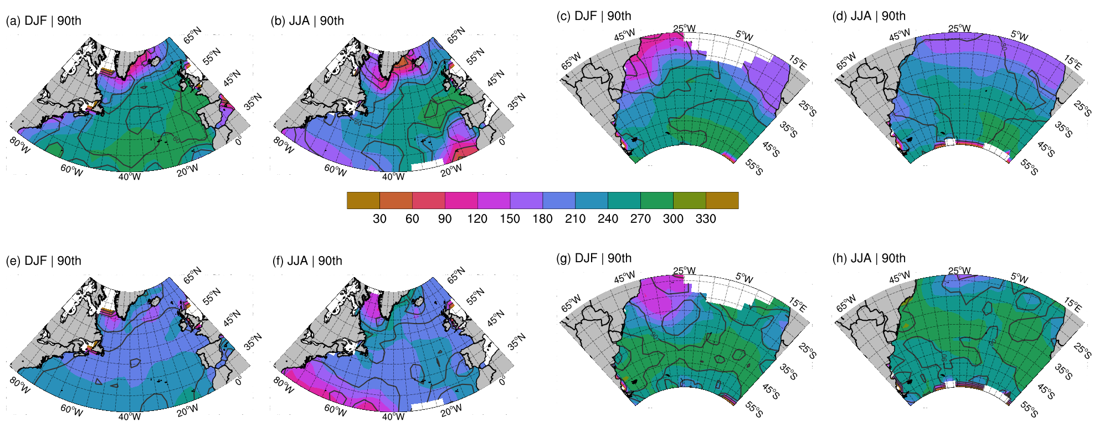
RESULTADOS & DISCUSSÃO
RESULTS & DISCUSSION
RESULTS AND DISCUSSION
East Central Domains:
mature cyclones, more intense and with a longer and more persistent track.
structure of fronts allows for more stable winds in the rear of the cold front
Spatial distribution of (a-d) mean wave direction of the cases and (e-h) sector of the cyclone where the extreme occurs (relative to the center of the cyclone), from Gramcianinov et al. (2022).
Gramcianinov et al. - Climatologia e tendência dos extremos de onda gerados por ciclones extratropicais… XIV OMARSAT 12/2021
Camargo and Gramcianinov IWMO2022 - Ann Arbor

Slide 23
RESULTADOS & DISCUSSÃO
RESULTS & DISCUSSION
RESULTS AND DISCUSSION
Western edge:
developing cyclones are weaker and smaller
warm conveyor belt relevance (e.g., Gramcianinov et al., 2020a)
greater movement of the fronts during development and intensification
Spatial distribution of (a-d) mean wave direction of the cases and (e-h) sector of the cyclone where the extreme occurs (relative to the center of the cyclone), from Gramcianinov et al. (2022).
Gramcianinov et al. - Climatologia e tendência dos extremos de onda gerados por ciclones extratropicais… XIV OMARSAT 12/2021
Camargo and Gramcianinov IWMO2022 - Ann Arbor

Slide 24
RESULTADOS & DISCUSSÃO
RESULTS & DISCUSSION
RESULTS AND DISCUSSION
Changes in the occurrence of wave extremes in 42 years:
signal may indicate increased/decreased event density or longer/short events.
4 regions selected for analysis:
East coast of the USA
Greenland
Northern British Isles
West coast of Europe
NA
NA
Gramcianinov et al. - Climatologia e tendência dos extremos de onda gerados por ciclones extratropicais… XIV OMARSAT 12/2021
Camargo and Gramcianinov IWMO2022 - Ann Arbor

Slide 25
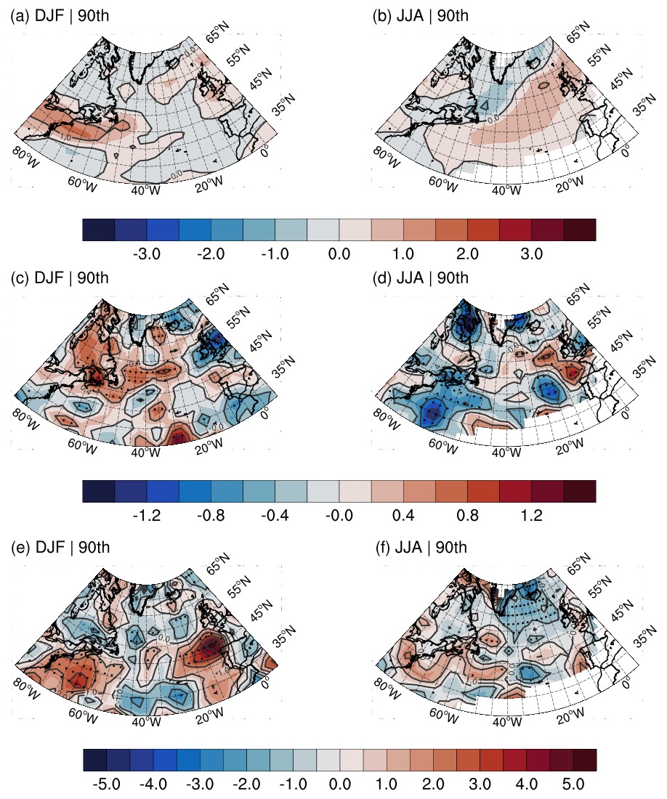
RESULTADOS & DISCUSSÃO
RESULTS & DISCUSSION
RESULTS AND DISCUSSION
NA
storm track
intensity
(vorticity)
cyclone
speed
Gramcianinov et al. - Climatologia e tendência dos extremos de onda gerados por ciclones extratropicais… XIV OMARSAT 12/2021
Camargo and Gramcianinov IWMO2022 - Ann Arbor

Slide 26
RESULTADOS & DISCUSSÃO
RESULTS & DISCUSSION
RESULTS AND DISCUSSION
NA
storm track
storm track
intensidade(vort.)
intensity
(vorticity)
velocidade
cyclone
speed
Gramcianinov et al. - Climatologia e tendência dos extremos de onda gerados por ciclones extratropicais… XIV OMARSAT 12/2021
Camargo and Gramcianinov IWMO2022 - Ann Arbor

Slide 27
RESULTADOS & DISCUSSÃO
RESULTS & DISCUSSION
RESULTS AND DISCUSSION
NA
storm track
storm track
intensidade(vort.)
intensity
(vorticity)
velocidade
cyclone
speed
Gramcianinov et al. - Climatologia e tendência dos extremos de onda gerados por ciclones extratropicais… XIV OMARSAT 12/2021
Camargo and Gramcianinov IWMO2022 - Ann Arbor

Slide 28
RESULTADOS & DISCUSSÃO
RESULTS & DISCUSSION
RESULTS AND DISCUSSION
SA
Changes in the occurrence of wave extremes in 42 years:
signal may indicate increased/decreased event density or longer/short events.
5 regions selected for analysis:
eastern Drake passage
along the coast of South America (45ºS-25ºS)
JJA: split in two
Central-East range between 55ºS and 40ºS.
coast of Namibia
Gramcianinov et al. - Climatologia e tendência dos extremos de onda gerados por ciclones extratropicais… XIV OMARSAT 12/2021
Camargo and Gramcianinov IWMO2022 - Ann Arbor

Slide 29
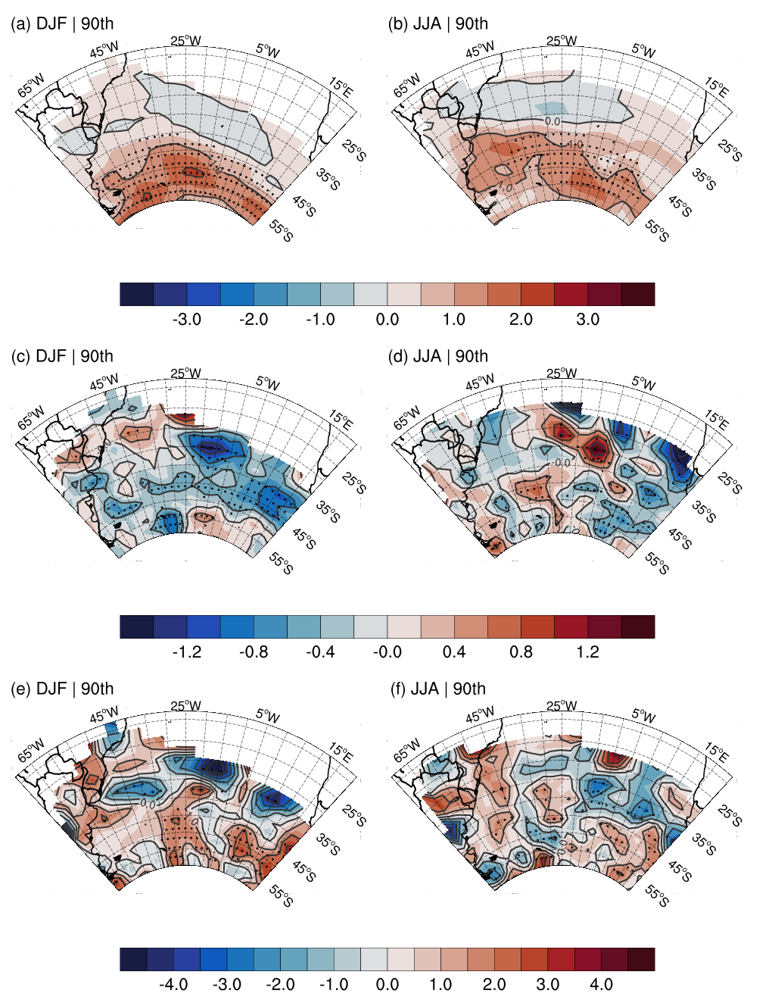
RESULTADOS & DISCUSSÃO
RESULTS & DISCUSSION
RESULTS AND DISCUSSION
SA
storm track
intensidade(vort.)
velocidade
Gramcianinov et al. - Climatologia e tendência dos extremos de onda gerados por ciclones extratropicais… XIV OMARSAT 12/2021
Camargo and Gramcianinov IWMO2022 - Ann Arbor

Slide 30
RESULTADOS & DISCUSSÃO
RESULTS & DISCUSSION
RESULTS AND DISCUSSION
SA
storm track
intensidade(vort.)
velocidade
Gramcianinov et al. - Climatologia e tendência dos extremos de onda gerados por ciclones extratropicais… XIV OMARSAT 12/2021
Camargo and Gramcianinov IWMO2022 - Ann Arbor

Slide 31
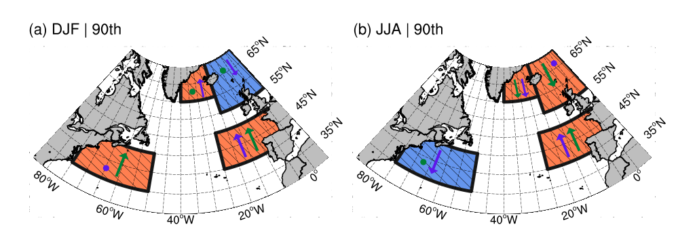
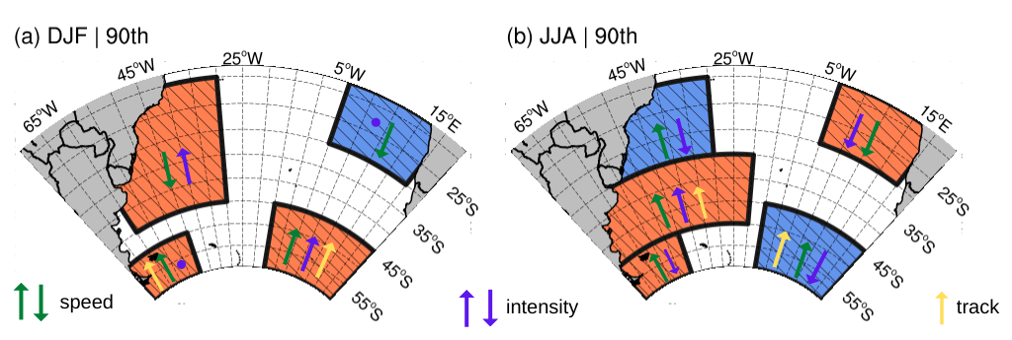
RESULTADOS & DISCUSSÃO
RESULTS & DISCUSSION
RESULTS AND DISCUSSION
Changes in trajectories do not directly justify changes in the occurrence of extremes:
lack of significance in the results harm the relationship
The change in intensity and speed plays an important role in the occurrence signal
Gramcianinov et al. - Climatologia e tendência dos extremos de onda gerados por ciclones extratropicais… XIV OMARSAT 12/2021
Camargo and Gramcianinov IWMO2022 - Ann Arbor

Slide 32
RESULTADOS & DISCUSSÃO
RESULTS & DISCUSSION
RESULTS AND DISCUSSION
The increase in intensity is decisive for the increase in cases, regardless of changes in speed
However, the decrease in intensity does not necessarily result in a decrease in cases → action of speed
Slowing down contributes to more events in these cases
Gramcianinov et al. - Climatologia e tendência dos extremos de onda gerados por ciclones extratropicais… XIV OMARSAT 12/2021
Camargo and Gramcianinov IWMO2022 - Ann Arbor

Slide 33
CONCLUSIONS
The results obtained by the new approach provided new insight into the relationship between cyclones and extreme wave weather, without contradicting existing climatology (e.g., Young, 1999; Vinoth and Young, 2011).
The regions with the highest occurrence of wave extremes are located in the central-eastern region of the ocean basins, associated with more mature cyclones that provide greater directional persistence of winds and longer runways.
The western edge also has a high density of occurrence, but with a lower mean Hs:
proximity to cyclogenetic regions;
cyclones under development, influence of conveyor belts.
Gramcianinov et al. - Climatologia e tendência dos extremos de onda gerados por ciclones extratropicais… XIV OMARSAT 12/2021
Camargo and Gramcianinov IWMO2022 - Ann Arbor

Slide 34
CONCLUSÃO
CONCLUSIONS
Changes in the occurrence of wave extremes generated by cyclones are controlled by the combination of changes in intensities and displacement speed of the system.
The increase in intensity has greater weight, having as a direct consequence an increase in the occurrence
In case of weakening of the cyclones, the speed enters as modulator:
increase in speed: decrease in occurrence
decrease in velocity: increase in occurrence → increase in cyclone interaction time with the sea surface → greater time for energy transfer and/or longer events.
intensity
decrease
increase
cyclone speed
occurrence increases
decrease
increase
occurrence
decreases
more events and/or longer events
less events and/or shorter events
Gramcianinov et al. - Climatologia e tendência dos extremos de onda gerados por ciclones extratropicais… XIV OMARSAT 12/2021
Camargo and Gramcianinov IWMO2022 - Ann Arbor

Slide 35
Thanks for your attention!
C. B. Gramcianinov, R. de Camargo, R. M. Campos et al. Impact of Extratropical Cyclone Intensity and Speed on the Extreme Wave Trends in the Atlantic Ocean, 21 October 2021, PREPRINT (Version 1) available at Research Square [https://doi.org/10.21203/rs.3.rs-995499/v1]
Questions or suggestions?
ricamarg@usp.br
cbgramcianinov@gmail.com
Gramcianinov et al. - Climatologia e tendência dos extremos de onda gerados por ciclones extratropicais… XIV OMARSAT 12/2021
Camargo and Gramcianinov IWMO2022 - Ann Arbor

Slide 36
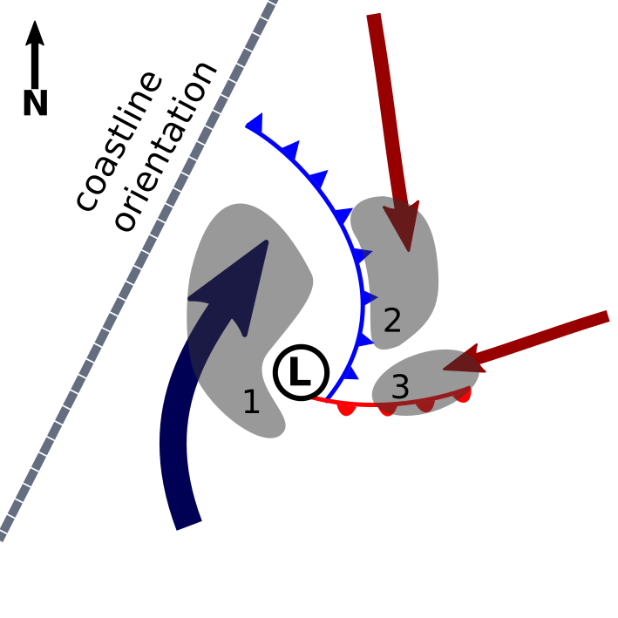
Source: Gramcianinov, C.B.; Campos R.M., Camargo, R. “Climate Change perspectives of the cyclones and oceanic hazards in the western South Atlantic Ocean”, Arquivos de Ciências do Mar (accepted)

Slide 37
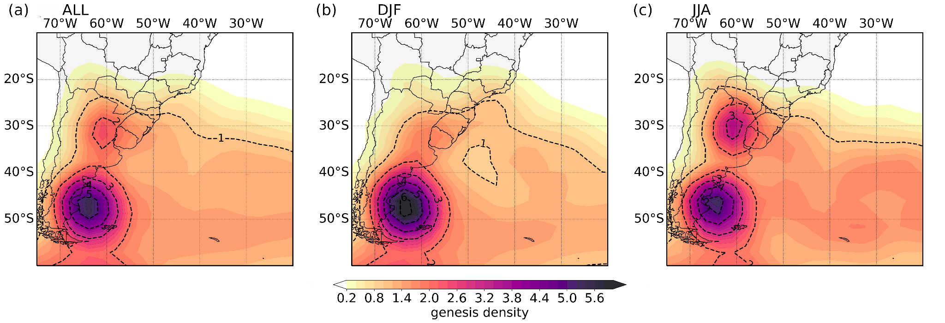
Source: Gramcianinov, C.B.; Campos R.M., Camargo, R. “Climate Change perspectives of the cyclones and oceanic hazards in the western South Atlantic Ocean”, Arquivos de Ciências do Mar (accepted)

Slide 38
